Slide 1
Topic: Arial 40
Author：Arial 23
Organzation ：Arial 23

Slide 2
-Part 1 Arial 33
Text Arial 28
Text Text Text Text Text Text Text Text Text Text Text Text

Slide 3
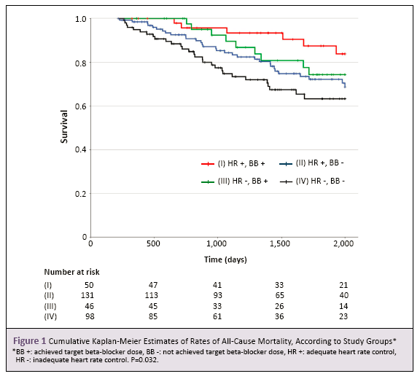
-Part 2
Text Text Text Text Text Text Text Text Text Text Text Text
Text Text Text Text Text Text Text Text Text Text Text Text

