Slide 1
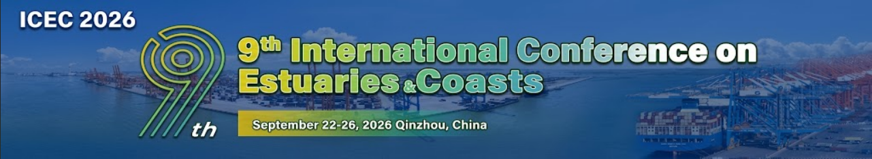






















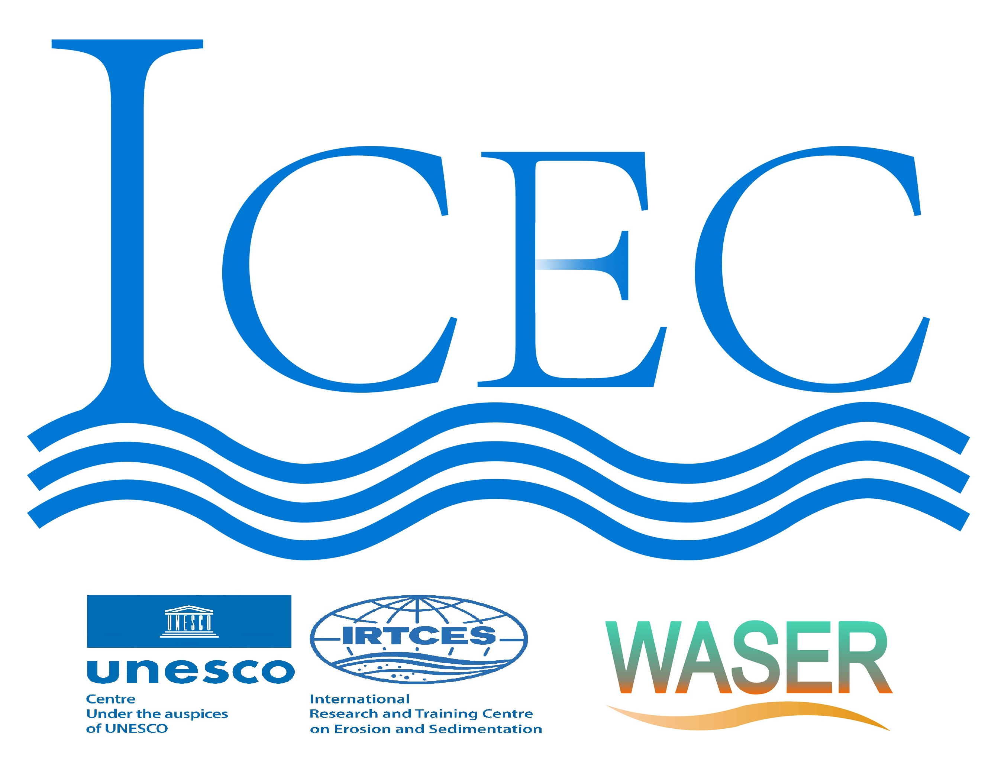
Authors and Affiliations
Background and Objectives
A brief overview of the study's purpose, methods, key findings, and conclusions.
It should provide a quick understanding of your work for those who may not have time to read the entire poster.
Results
Present your key findings using visual aids such as graphs, tables, diagrams, images, or other relevant illustrations.
These visuals should be clear, self-explanatory, and appropriately labeled.
Include only the most important and relevant results that support your conclu-
sions and avoid overwhelming the viewer with excessive data.
87%
64%
43%
  31%
Methodology
Describe the research design, participants (if applicable), data collection meth- ods, instruments, procedures, and statistical analyses used.
This section should be detailed enough for others to understand and replicate your study, but concise enough to avoid overwhelming the viewer.
46%
Conclusions and discussion
Summarize the main outcomes of your study, interpret their significance, and relate them back to the research question or hypothesis.
Discuss any implications, limitations, future directions, or practical applications of your findings.
Host:
China Institute of Water Resources and Hydropower Research (IWHR)
Qinzhou Municipal People's Government
Department of Water Resources of Guangxi Zhuang Autonomous Region
Department of Transportation of Guangxi Zhuang Autonomous Region
Organizer:
State Key Laboratory of Water Cycle and Water Security
International Research and Training Center on Erosion and Sedimentation (IRTCES)
Pinglu Canal Group Co., Ltd
Beibu Gulf University
Guangxi University
Guangxi Normal University
Guangxi Zhuang Autonomous Region Institute of Water Resources and Hydropower Research
China Ministry of Water Resources Key Laboratory of Sediment Science and Northern River Training
Key Laboratory of the Pearl River Estuary Regulation and Protection of Ministry of Water Resources
Guangxi Modern Canal Laboratory
Guangxi Key Laboratory of Marine Environmental Disaster Processes and Ecological Protection Technology
Guangxi Key Laboratory of Hydraulic Engineering Materials and Structures
Supporter:
World Association for Sedimentation and Erosion Research (WASER)
International Association for Hydro-Environment Engineering and Research (IAHR)
UNESCO Intergovernmental Hydrological Programme (IHP)
UNESCO International Sediment Initiative (ISI)

