Slide 1

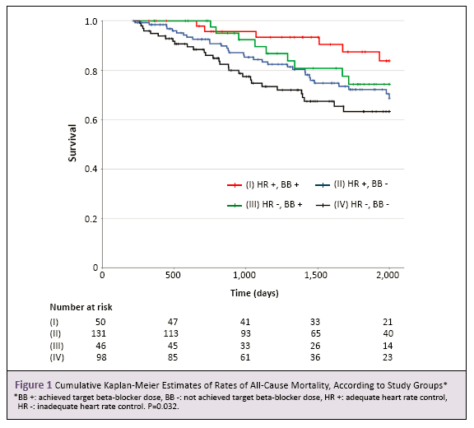
Topic：Arial 40
Author：23 Arial
Organzation：23 Arial
Please DO NOT change the page format or increase the number of page. The layout style can be modified.
Please save it only in format .ppt or .pptx
objective
Sample Sample Sample Sample Sample Sample
Sample Sample Sample Sample Sample Sample
Sample Sample Sample Sample Sample Sample
Sample Sample Sample Sample Sample Sample
Sample Sample Sample Sample Sample Sample
Sample Sample Sample Sample Sample Sample
Sample Sample Sample Sample Sample Sample
Sample Sample Sample Sample Sample Sample
Method
Sample Sample Sample Sample Sample Sample
Sample Sample Sample Sample Sample Sample
Sample Sample Sample Sample Sample Sample
Sample Sample Sample Sample Sample Sample
Sample Sample Sample Sample Sample Sample
Sample Sample Sample Sample Sample Sample
Sample Sample Sample Sample Sample Sample
Results
Sample Sample Sample Sample Sample Sample
Sample Sample Sample Sample Sample Sample
Sample Sample Sample Sample Sample Sample
Sample Sample Sample Sample Sample Sample
Sample Sample Sample Sample Sample Sample
Sample Sample Sample Sample Sample Sample
Sample Sample Sample Sample Sample Sample
Sample Sample Sample Sample Sample Sample
Sample Sample Sample Sample Sample Sample
Sample Sample Sample Sample Sample Sample
Sample Sample Sample Sample Sample Sample
Sample Sample Sample Sample Sample Sample
Sample Sample Sample Sample Sample Sample
Sample Sample Sample Sample Sample Sample
Sample Sample Sample Sample Sample Sample
Sample Sample Sample Sample Sample Sample
Sample Sample Sample Sample Sample Sample
Sample Sample Sample Sample Sample Sample
Sample Sample Sample Sample Sample Sample
Sample Sample Sample Sample Sample Sample
Sample Sample Sample Sample Sample Sample
Sample Sample Sample Sample Sample Sample
Sample Sample Sample Sample Sample Sample
Sample Sample Sample Sample Sample Sample
Sample Sample Sample Sample Sample Sample
Sample Sample Sample Sample Sample Sample
conclusion
Sample Sample Sample Sample Sample Sample Sample Sample Sample Sample
Sample Sample Sample Sample Sample Sample Sample Sample Sample Sample Sample Sample Sample Sample Sample
Sample Sample Sample Sample Sample
Sample Sample Sample Sample Sample Sample Sample Sample Sample Sample
Sample Sample Sample Sample Sample
Sample Sample Sample Sample Sample Sample Sample Sample Sample Sample
Sample Sample Sample Sample Sample
Sample Sample Sample Sample Sample Sample Sample Sample Sample Sample
Sample Sample Sample Sample Sample
Sample Sample Sample Sample Sample Sample Sample Sample Sample Sample
Sample Sample Sample Sample Sample
Sample Sample Sample Sample Sample Sample Sample Sample Sample Sample
Sample Sample Sample Sample Sample
Sample Sample Sample Sample Sample Sample Sample Sample Sample Sample
Sample Sample Sample Sample Sample

