Slide 1
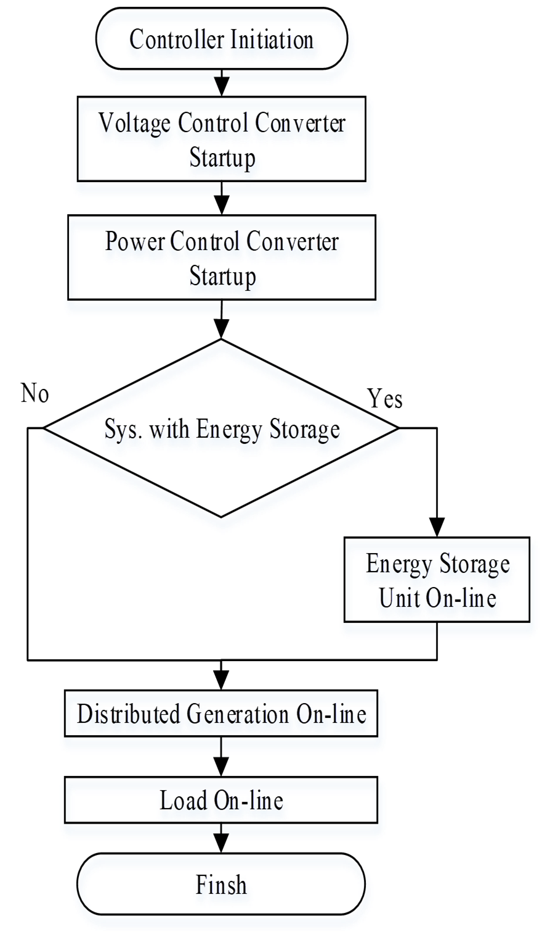
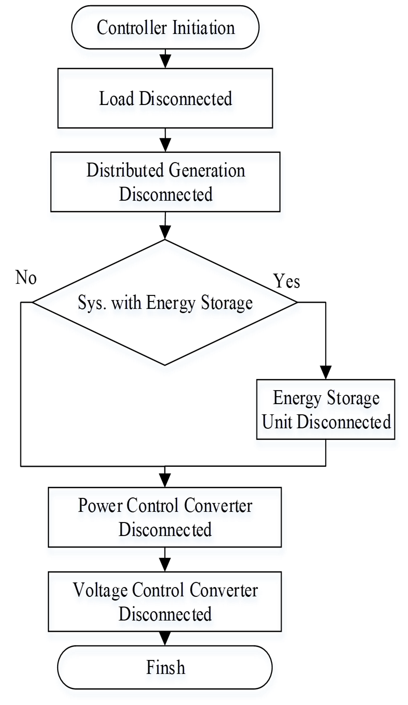
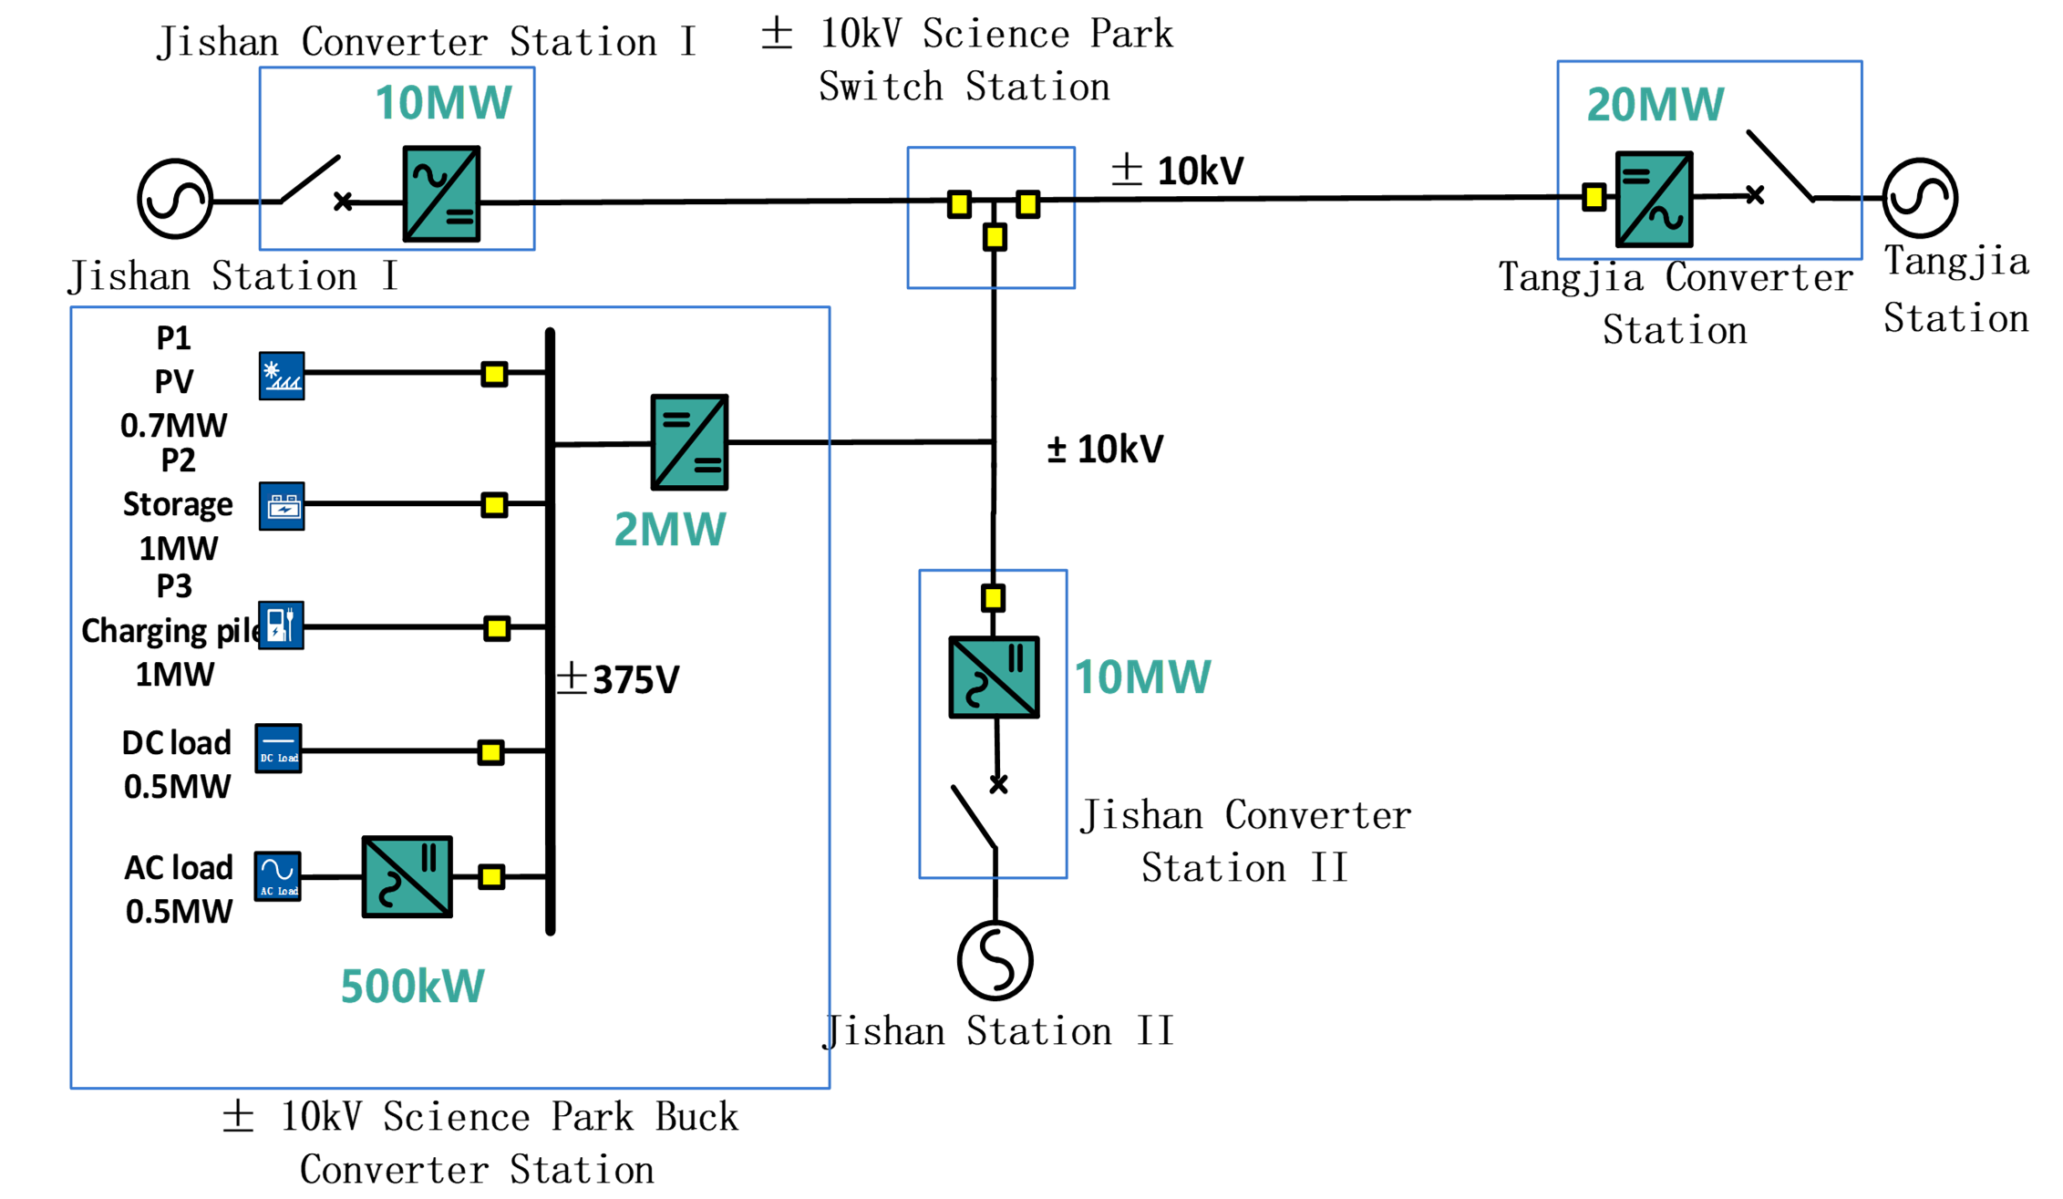
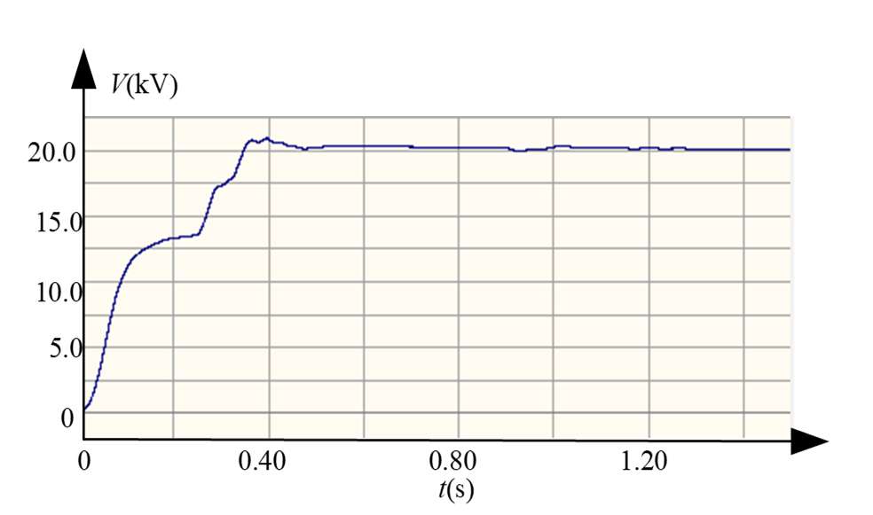
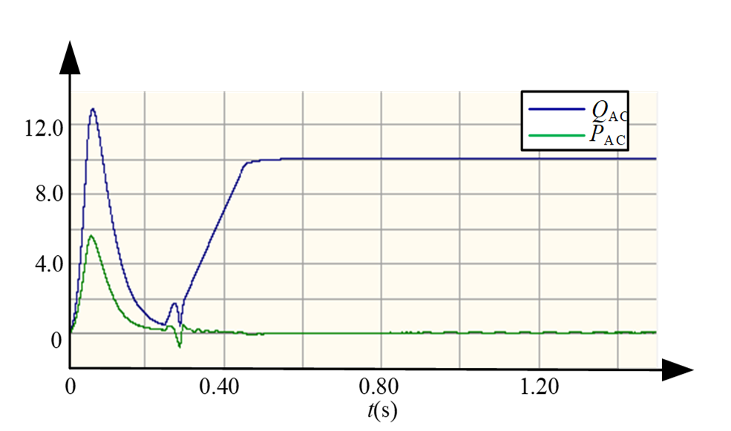
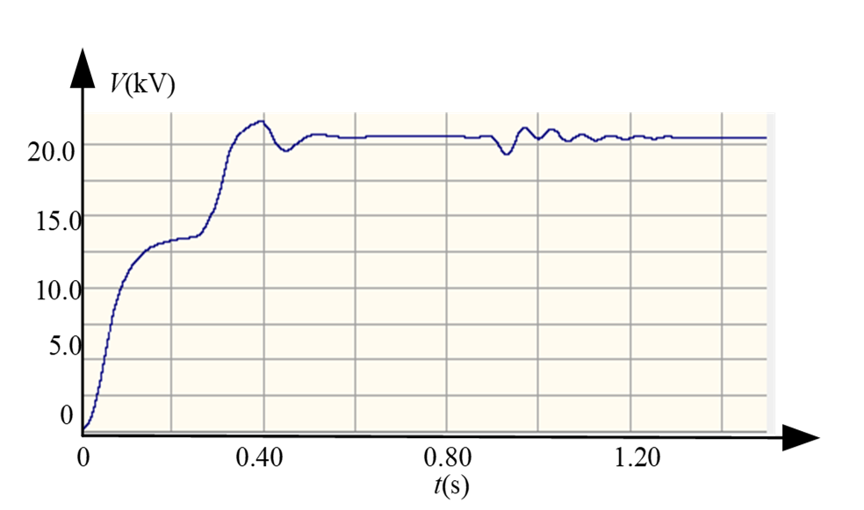
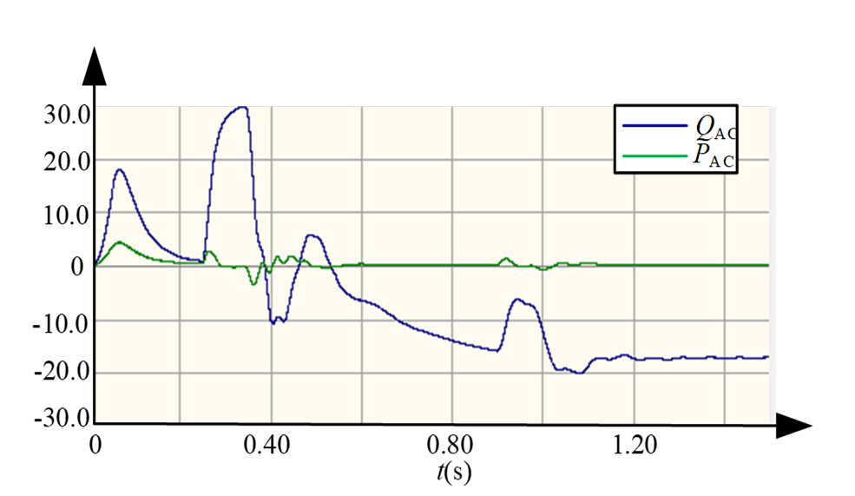
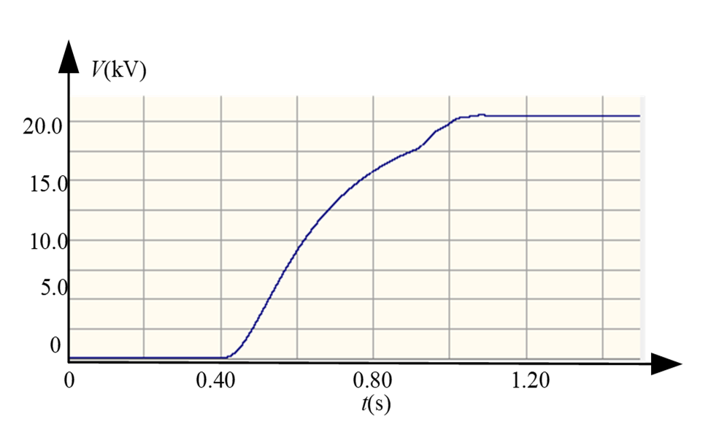
Title of the paper
Author: Author ¹, Author ², ……
Company: 1.XXX; 2. XXX
I. INTRODUCTION
The fast start-stop of the flexible DC distribution system is the basis of ensuring the safe and reliable operation of the flexible DC distribution system. Therefore, the start-stop control of the flexible DC distribution system is studied in this paper. Firstly, the typical structure of the flexible DC distribution system is given. Then, the timing and logic of the access and exit of different power supply and load and start and stop of system are designed. Finally, the overall operation of modular multi-level converter, DC transformer and DC distribution system during start-up process is analyzed by simulation. The research results can be used for reference in theoretical research and engineering practice of the flexible DC distribution system.
II. INTRODUCTION OF THE SYSTEM
A typical ±10kV/±375V flexible DC power system structure is shown in Figure 1. In order to realize the function of power transfer and improve the power supply reliability of the distribution network, the system adopts a "star" network topology with three independent AC power sources. In order to improve the power quality of the AC distribution network connected to the DC power distribution system, the three-terminal AC system and the medium voltage DC power distribution bus are connected by a fully-controlled voltage source converter.
Fig. 2 Flowchart of the start-up of DC power distribution system.
Fig. 3 Flow chart of the shutdown of DC power distribution system.
IV. SIMULATION AND ANALYSIS
As can be seen from Figure 4, the voltage and current do not exceed the set value. After the DC voltage is stabilized, the access sequence of each networking component (Jishan I station, Jishan II station, DC microgrid) can be in no particular order, but simultaneous access should be avoided.
Fig. 1 Topology of medium-voltage DC power distribution system.
Ⅲ. START AND STOP CONTROL
The core of DC distribution system start-up is to establish a stable DC voltage, followed by converter power control. If there is a bi-directional controllable energy storage device in the system, it can be connected to the system in the next link to suppress the power fluctuation caused by the access to renewable energy; then it can be connected to renewable energy, and finally to AC and DC loads. According to this idea, the starting process of DC distribution system is shown in Figure 2.
The shutdown process of the DC power distribution system is opposite to the startup process. The principle of normal outage is to ensure the stability of the DC voltage during the outage process and to stop the operation according to the controllable degree. Therefore, the outage control first removes the load, then removes the renewable energy such as wind power, photovoltaics, and then cuts off the energy storage device, and finally cuts off the voltage source type inverter that controls the DC voltage, as shown in Figure3.
Fig. 4 Simulation results of start-up process of DC power distribution system.
(a) DC voltage of Tangjia Station, (b) Active power and reactive power of Tangjia Station (c) DC voltage of Jishan Station (d) Active power and reactive power of Jishan Station (e) DC voltage of DC transformer
V. CONCLUSION
In this paper, the start-stop control strategy of the flexible DC power distribution system is designed. On this basis, based on a typical DC distribution network system architecture, the startup process of each device and the whole system are simulated and analyzed. The results show that the design method and scheme of this paper are in line with the operational requirements of flexible DC power distribution system. The results of this paper can be extended to the design and research of other DC power distribution systems.
Tel:
E-Mail:
Paper ID:

