Slide 1
Abstract Submission Guideline

Slide 2
1. Choose English Website, Click “Abstract Submission”
Website：https://acn2023.sciconf.cn/en/web/index/

Slide 3
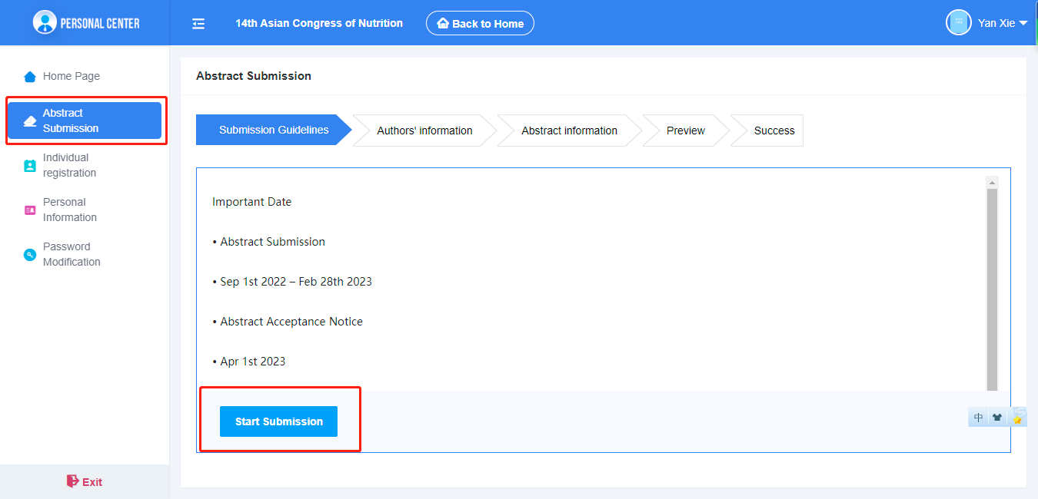
2. Click “Abstract Submission”, read the guidelines carefully and click “Start Submission”.

Slide 4
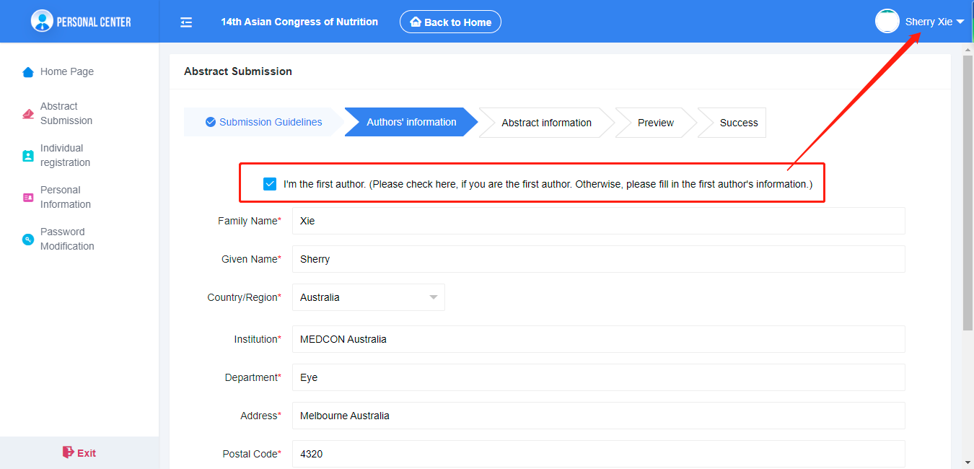
3. Start submission, enter to the first author page. All the blanks with “*”are required to fill. If you tick “I’m the first author”, it will be automatically filled with the information of the account you loged in.

Slide 5
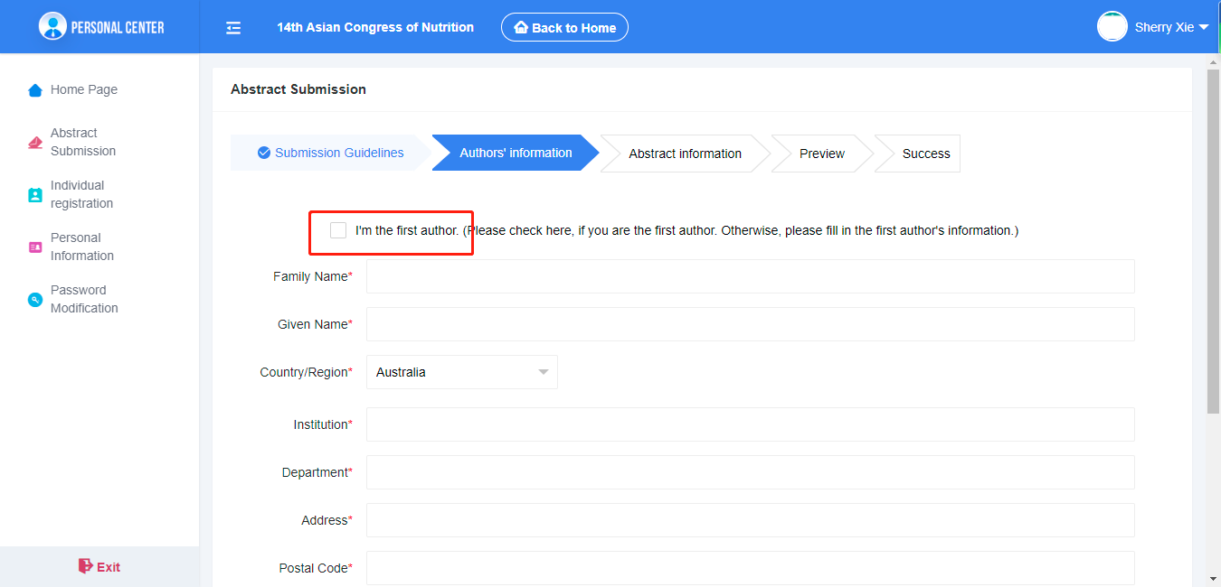
4. If you don’t tick “I’m the first author”, you may fill the blanks accordingly.

Slide 6
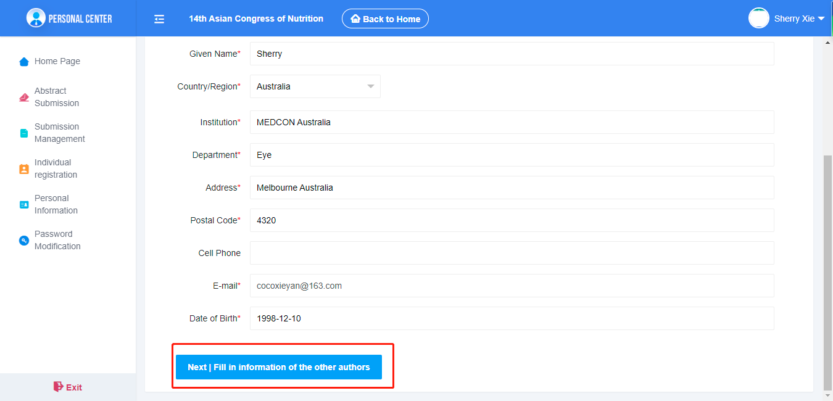
5. After you fill all nessessary informaiton, click “next”.

Slide 7
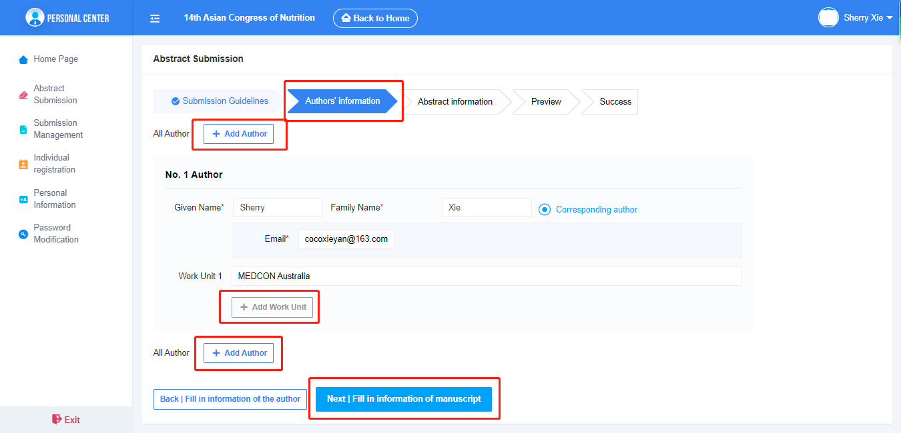
6. You may add more authors on this page. If the author has more then one work unit, you may add more work unit too. Click “Next” to next page.

Slide 8
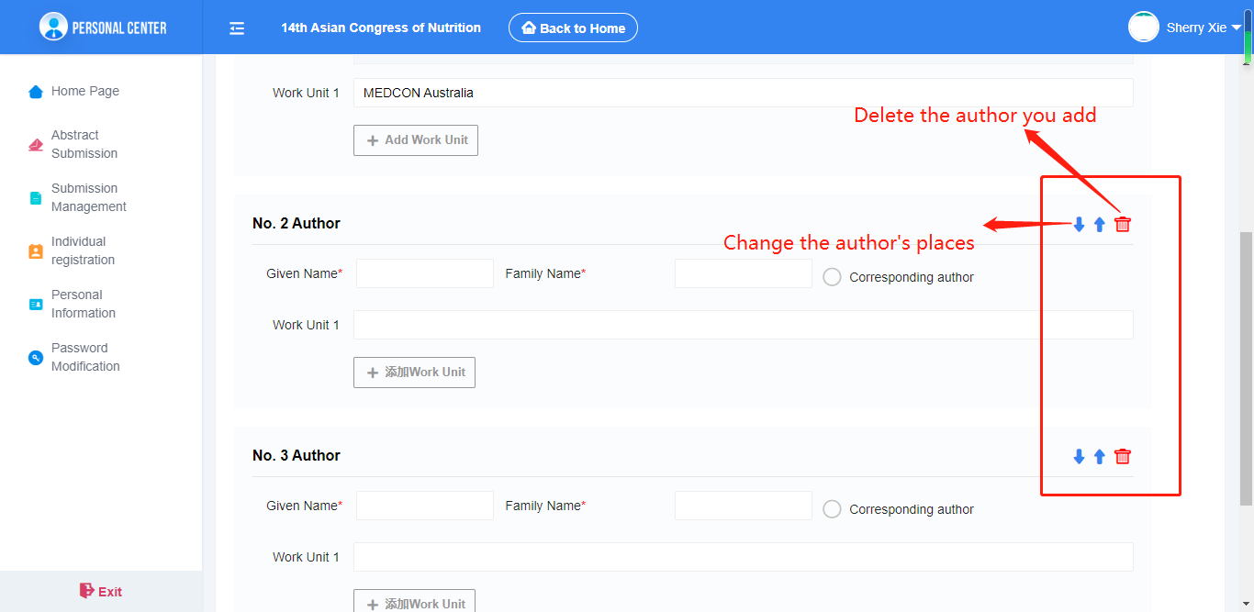
7.Once you add more then two authors, you can change their place by click “↑” or “↓” and you can also delete the author you add. The first author will be fix on the first place. If you want to change the first author, please find more in this PPT on page 13 and 14.

Slide 9
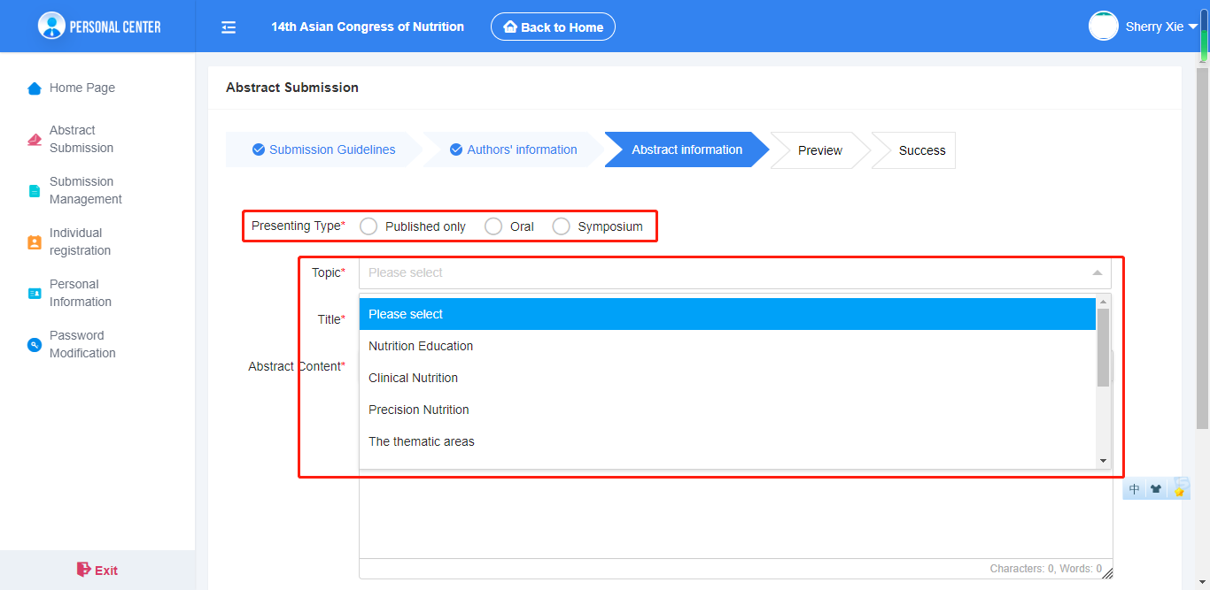
8. Start to submit the content of your abstract. Choose the presenting type and the Topic, and fill the centents. Please follow the guide to the next page.

Slide 10
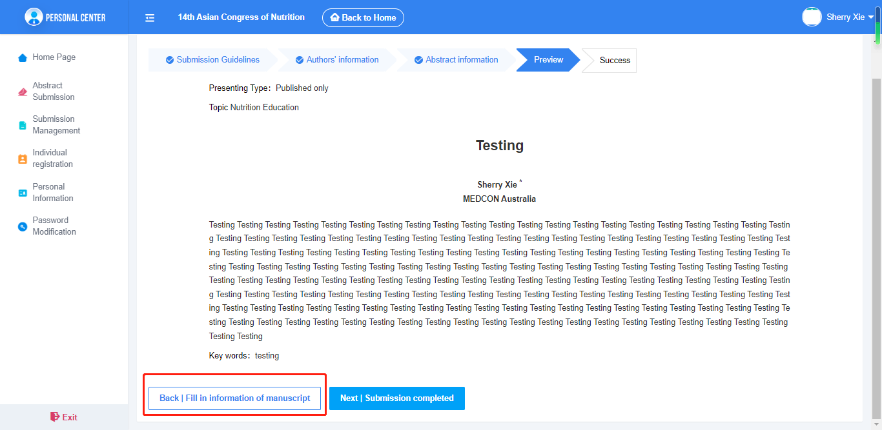
9. You may preview your abstract on this page. If there is anything need to be changed, click “Back”and you can make the nessessary changes. If no, then confirm and click “Next”.

Slide 11
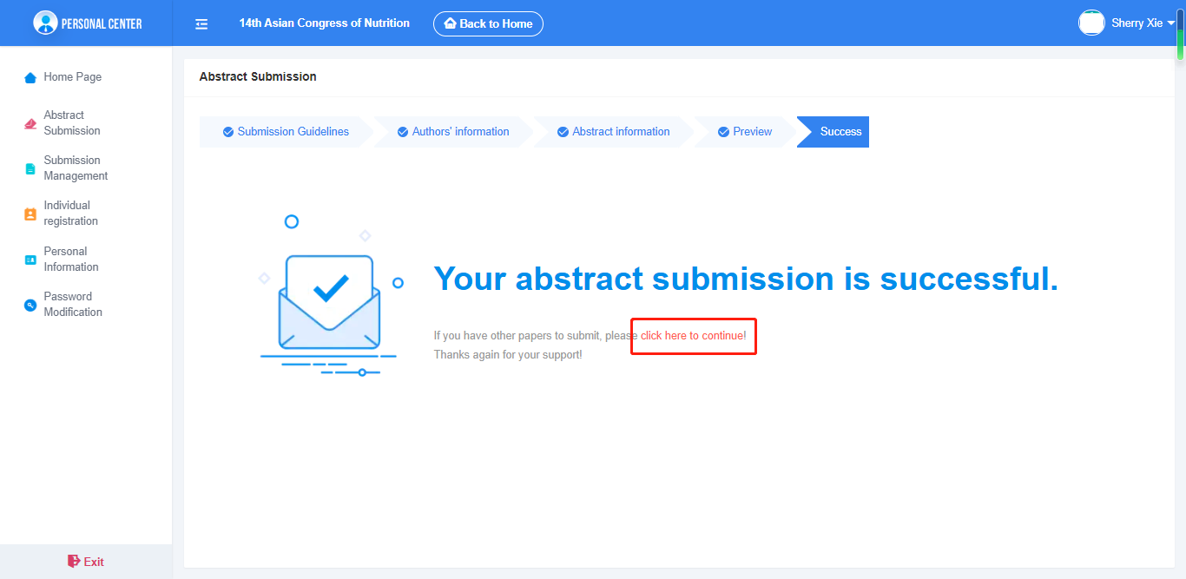
10. Then you will see that your abstract submission is successful. If you have some more abstract to submite, “click here to continue”will let you to submit another abstract again.

Slide 12
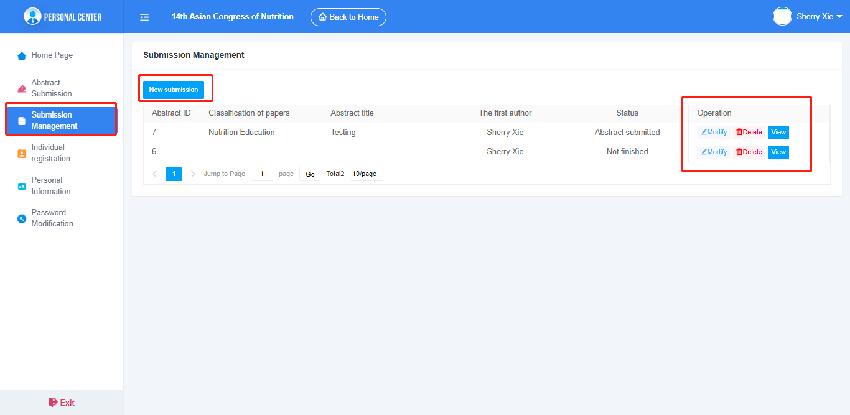
11. On the left side, click “Submission Management”, you can check the status of your abstract acceptance and you can modify them before the deadline and also you can delete it before the dealine.

Slide 13
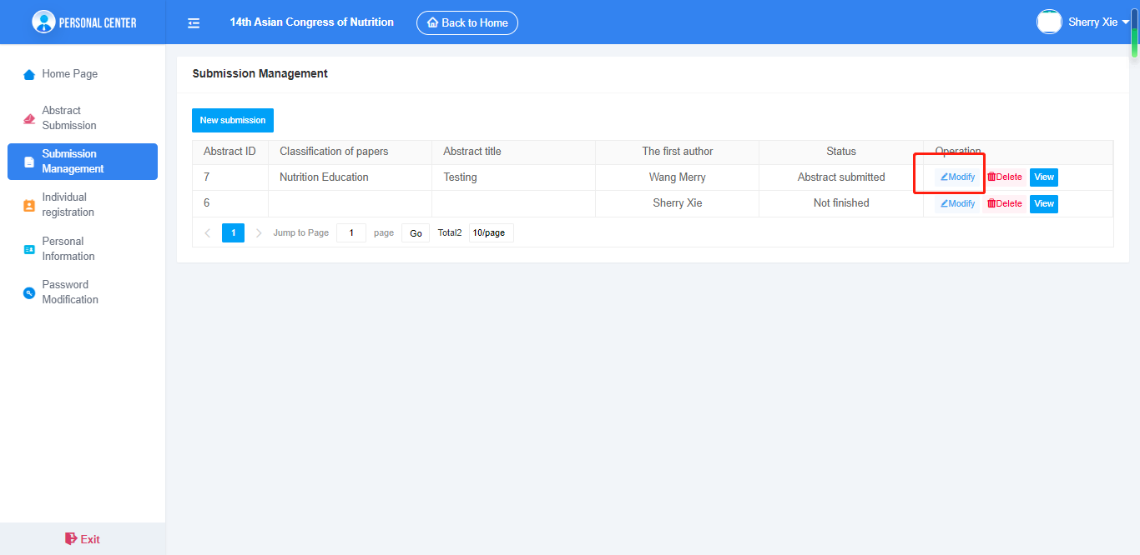
12. Click modify, you may also change the first author too.

Slide 14
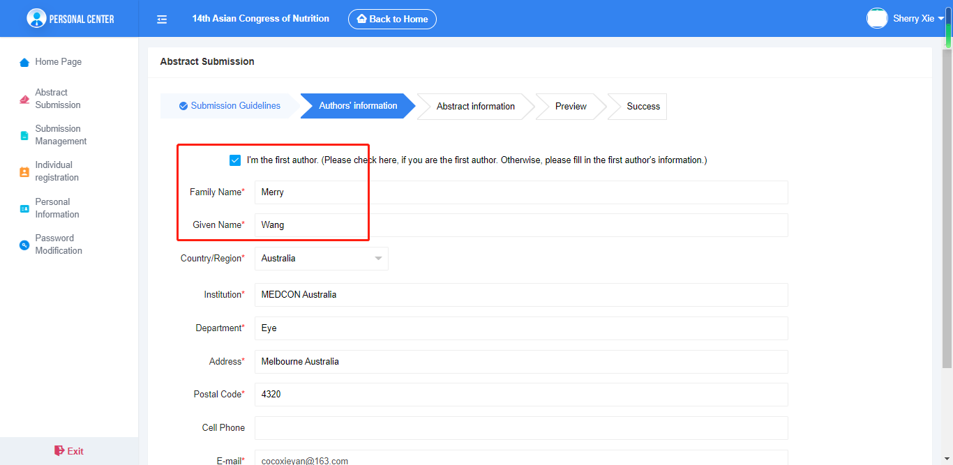
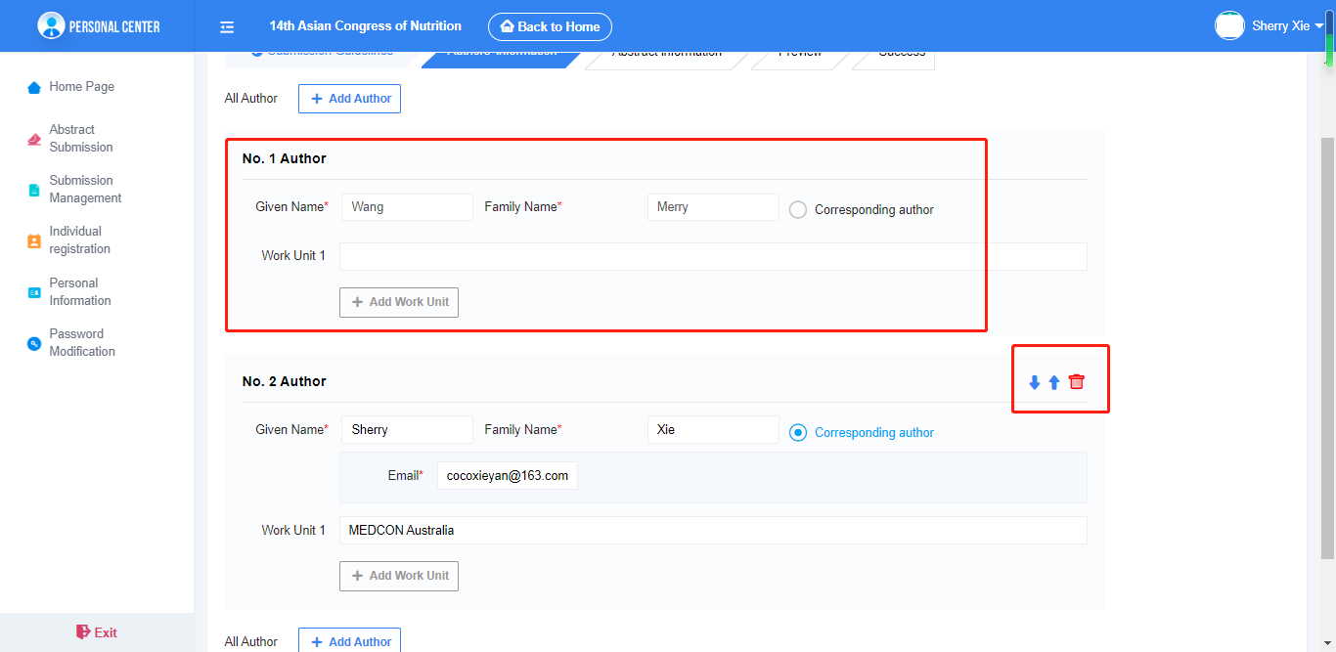
13. Modify the first author, change the informations on the first author page and then next. Click the “↑” or “↓” to place the first author to the first place. But once the first author been placed , you cann’t change it or remove it. If you want to change it again, then you may go back to modify and start over this steps again.

