Slide 1
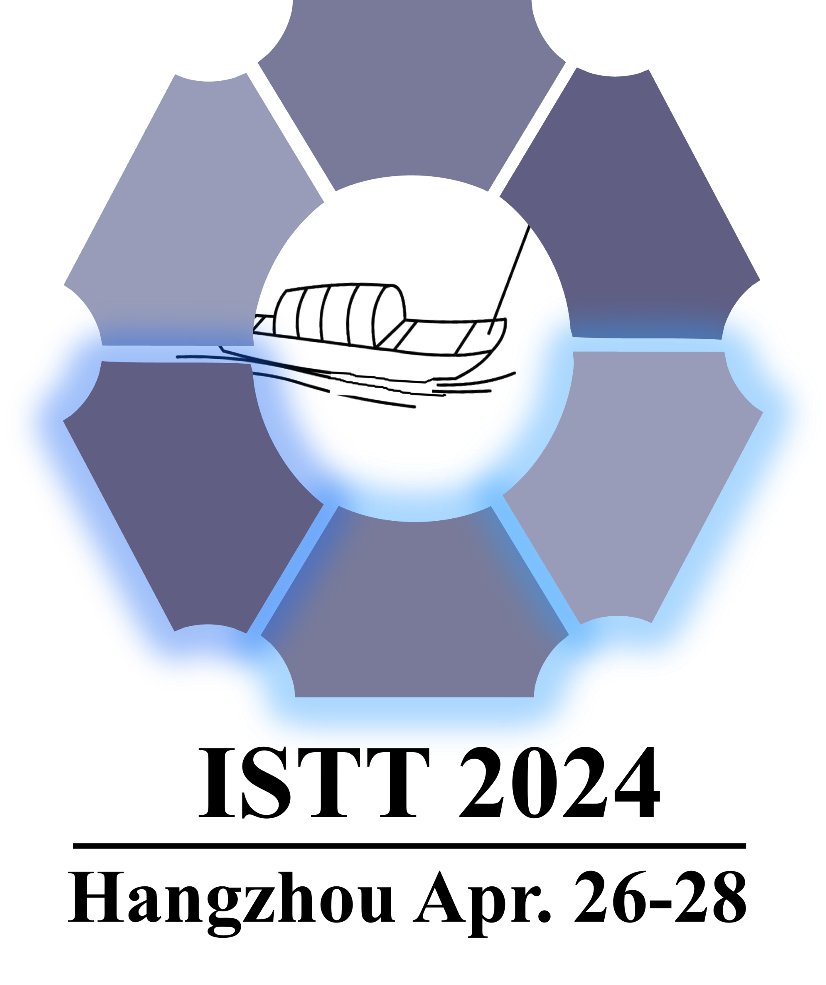
1st International Symposium on Transmembrane Transporters
Ion channel and carrier functionality
Title
Name
Address
Emails
Abstract
Related Publications:
[1]
[2]

