Slide 1
Building a Scalable and Interpretable End-to-End Data Science Ecosystem Using Statistics, ML and Genomics and Health Sciences
Empowering a Scalable End-to-End Ecosystem for Whole Genome Sequencing Integrative Analysis
Xihong Lin
Department of Biostatistics and Department of Statistics
Harvard University

Slide 2
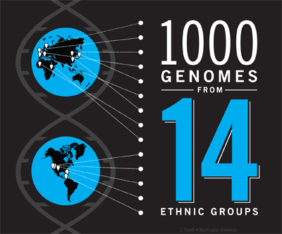
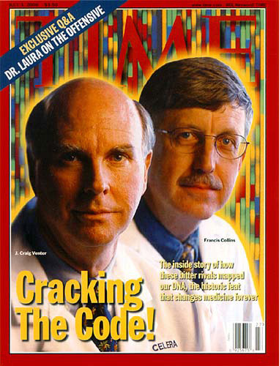
GSP-CCDG (NHGRI) N=140,000 WGS & 210,000 WES
IHCS(NCI)
N=200,000
1000 Genomes N=1000
2008
2016
2019
Multi-Ancestry Whole Genome Sequencing Timeline
2001
2015
2018
Completion of Mapping a Single Human Genome
Biobanks
(UKB: N=500,000
MVP: N=1M
AllofUs: N=1M)
TOPMed (NHLBI)
N=200,000
Notes:
What is blending?

Slide 3
Data Science Ecosystem
Diverse and Fair Data
Full scientist (Quantitative + Domain science)
Communication skills (domain science + CS)
Impact in science: solve big problems by working together
Stats, ML and AI Methods Tools & Infrastructure
Data Analysis
& Result Intepretation

Slide 4
Part #1: Data Fairness Outweights Data Size
For big data, bias is more important than variance

Slide 5
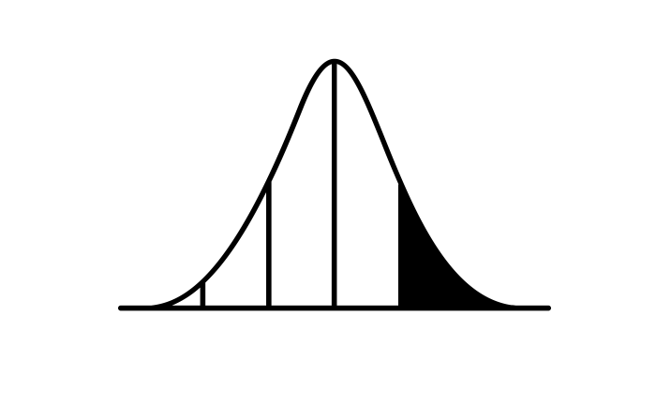
Polygenic Risk Score (PRS aggregate small genetic effects using GWAS for risk prediction and stratification
GWAS
Summary Stats
SNP weights
Patient genotypes
Risk stratification
Notes:
0) PRS for helping inform clinical decisions such as early screening or treatment plans
While using individual-level genotypic and phenotypic data are ideal, they can be difficult to access AND difficult to handle computationally
We can use publicly available data to achieve very similar performance
GWAS is useful but even highly significant SNPs may have miniscule effects on their own
Use some kind of method for selecting SNPs and their weights
Patient genotype in-house to generate a risk score
Compare against a population distribution to evaluate risk
Will talk through a couple of popular methods
Images from thenounproject.com
Table: useiconic.com
Calculator : Fevzi.Co
DNA: Pham Thi Dieu Linh
Curve: Robbe de Clerck

Slide 6
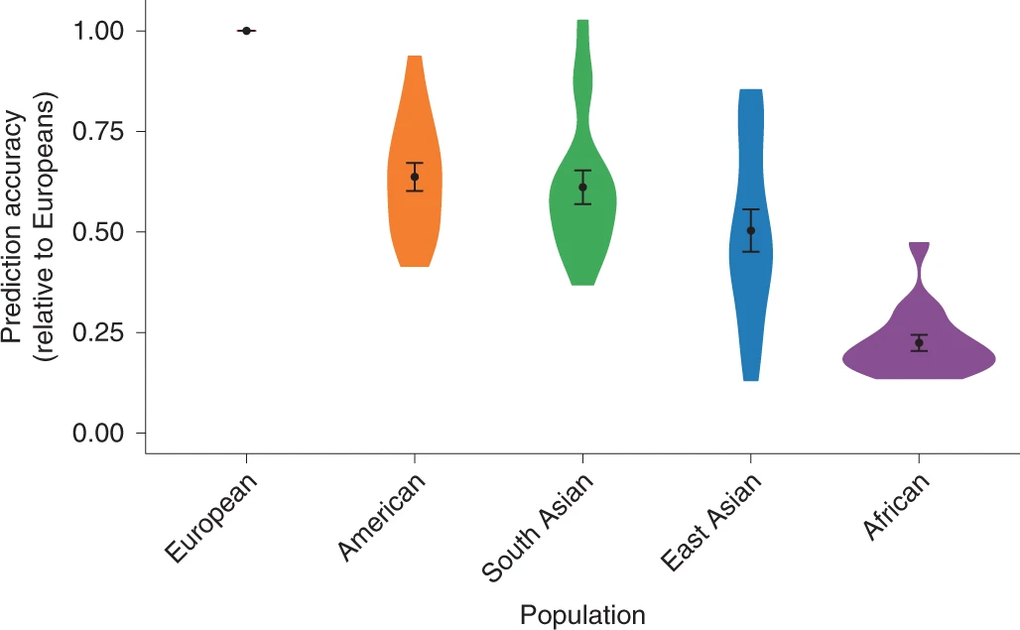
Fairness: Polygenic Risk Score (PRS) using European whole genome (GWAS) data perform poorly in other populations
Importance of
data fairness
Algorithm fairness
Transfer learning
Martin, et al, 2019

Slide 7
Large Biobanks and WGS Studies are Diverse
Do Deep Learning models significantly improve the performance PRS compared with existing methods?
A good number of people have tried DL-PRS but the results are not encouraging.
Why?
GWAS signals are weak and mainly linear

Slide 8
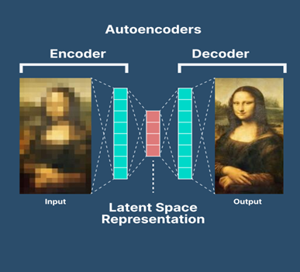
Large Biobanks and WGS Studies are Diverse
Autoencoder

Slide 9
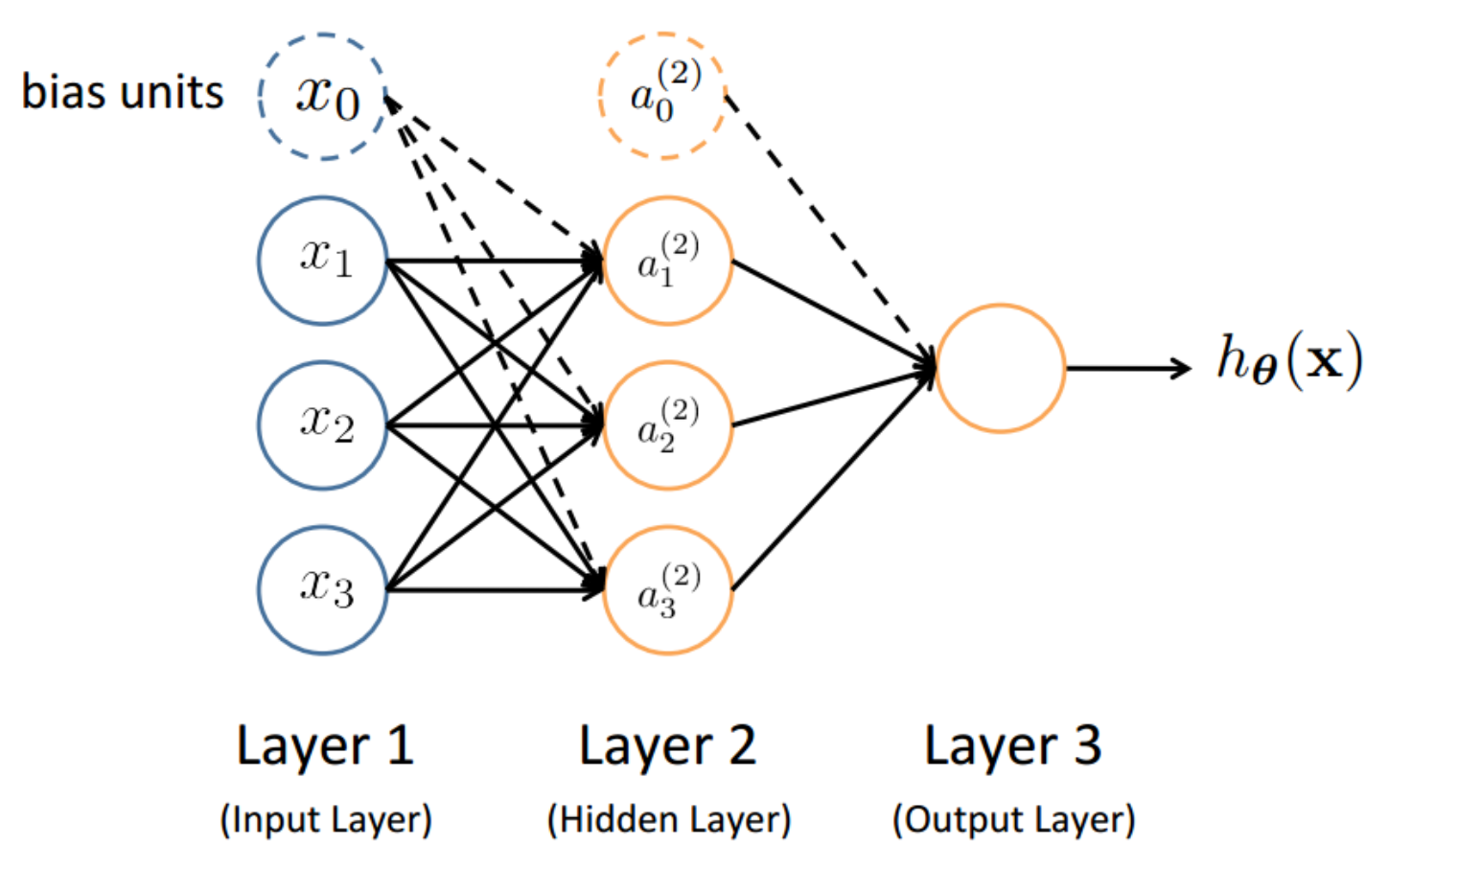
Nonlinear Encoder: Feed-Forward Neural Network
$a^{(1)}=x$
p=4 (including intercept)
$a_{m}^{\left(2\right)}$= activation of unit $m$ in layer 2
$a_{m}^{\left(2\right)}=f(W_{m}^{\left(1\right)T}x+b_{m}^{(1)})$
Vector form:
$$a^{(2)}=f(W^{\left(1\right) }x+b^{\left(1\right)})$$
$f\left(⋅\right)=$ activation function

Slide 10
Nonlinear Encoder: Feed-Forward Neural Network
The same activation function $f\left(⋅\right)$ is applied to all units
$h_{θ}\left(x\right)=f\left(W^{\left(2\right)T}a^{\left(2\right)}+b^{\left(2\right)}\right)$
$=$ $f\left(W^{\left(2\right)T}f(W^{\left(1\right) }x+b^{\left(1\right)}) +b^{\left(2\right)}\right)$
When effects are linear, CNN and DL are not necessary

Slide 11
Part #2: More fully leverage summary statistics for advanced analysis without individual-level data

Slide 12
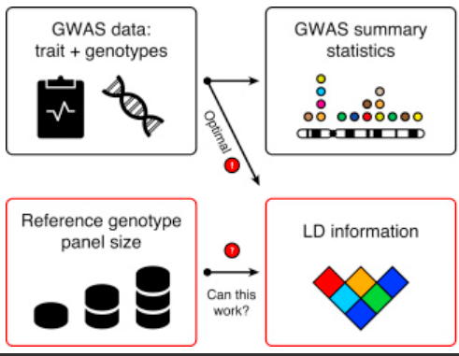
Large Biobanks and WGS Studies are Diverse
GWAS Summary statistics are widely publicly available
$$X^{′}Y$$
Due to privacy protection, individual level data are generally not publicly available.
GWAS summary statistics are widely publicly available.
Q: What can summary statistics (X’X, X’Y) be used for besides linear regression and meta analysis?
X’X

Slide 13
ALL-SUM: Aggregated L0Learn using SUMmary statistics for PRS
L0Learn for PRS using individual level data
Q: Can we calculate penalized likelihood-based L0Learn $\hat{β}$ using GWAS summary statistics ${R=X}^{′}X$and ${S=X}^{′}Y$?
A: Yes (ALL-SUM)
$$\hat{β}={argmin}_{β∈R^{p}}\frac{1}{2}{\left|\left|Y−Xβ\right|\right|}_{2}^{2}+λ_{0}{\left|\left|β\right|\right|}_{0}+λ_{2}{\left|\left|β\right|\right|}_{2}^{2}$$
Number of nonzero entries
Magnitude of coefficients
Chen, et al, PNAS, in press

Slide 14
ALL-SUM: Coordinate descent optimization for Summary stats based L0L2 regression
Step 2: Ensemble tuning-specific coefficients estimates
Step 1: Given $λ_{0}$ and $λ_{2}$, update ${\hat{β}}_{j}^{\left(t\right)}$ iteratively at step $t$ using S and R by:
$${\hat{β}}_{j}^{\left(t\right)}=\frac{{\tilde{β}}_{j}^{\left(t\right)}}{1+2λ_{2}}⋅I\left(\left|{\tilde{β}}_{j}^{\left(t\right)}\right|>\sqrt{2λ_{0}\left(1+2λ_{2}\right)}\right)$$
where ${\tilde{β}}_{j}=s_{j}−R_{j,−j}β_{−j}^{\left(t−1\right)}$
$${\hat{β}}^{\left(1\right)}$$
$${\hat{β}}^{\left(K\right)}$$
$${\left(λ_{0},λ_{2}\right)}^{\left(1\right)}$$
$$⋯$$
$${\left(λ_{0},λ_{2}\right)}^{\left(K\right)}$$

Slide 15
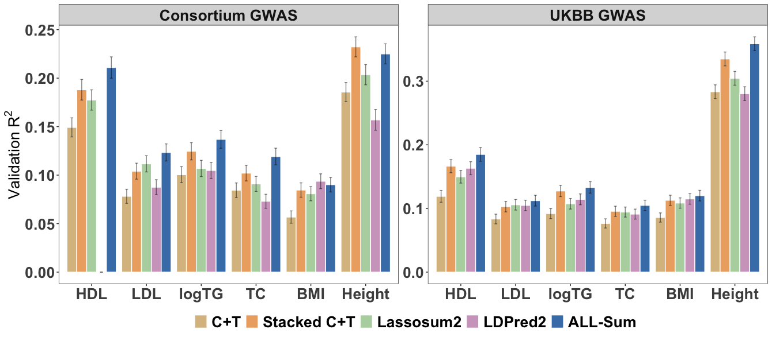
ALL-Sum achieves high prediction accuracy for continuous traits
Notes:
LDPred2 doesn’t converge for anything for HDL-GLGC

Slide 16
Part #3: Scalability is Critical for Analyzing Big Data
Interpretable Sparsity Makes a Difference

Slide 17
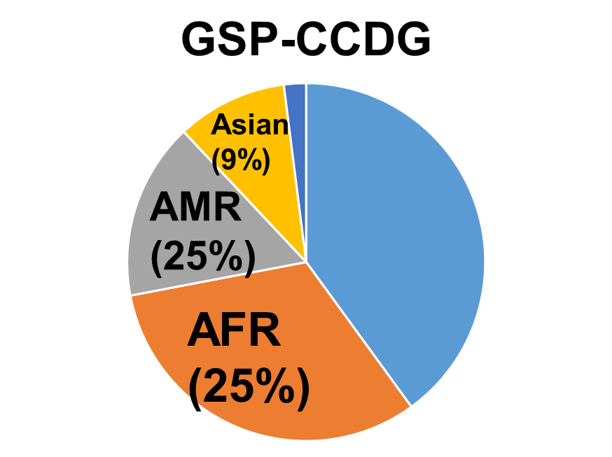
Data Fairness: Large Biobanks and WGS Studies are Diverse
Multi-Ancestry
EUR (40%)
EUR (40%)
EUR (52%)
n=185,000 (WGS) n=135,000(WGS) n=250,000 WGS
+210 (WES)

Slide 18
Massive Rare Variants in WGS Data
(TOPMed Freeze 10a (n=185,000))
Type | Category | PASS Variants | Singletons | Doubletons | MAF > .0001 | MAF > .001 | MAF > .005 | MAF > .05
SNP | All | 845M | 44.7% | 15.6% | 4.61% | 1.18% | 0.98% | 0.75%
 | Synonymous | 3.17M | 41.0% | 15.1% | 5.29% | 1.28% | 0.97% | 0.66%
 | Missense | 6.74M | 45.4% | 15.7% | 3.91% | 0.79% | 0.51% | 0.28%
 | pLoF | 442K | 52.2% | 16.2% | 2.53% | 0.52% | 0.35% | 0.23%
Indels | All | 70.5M | 46.6% | 15.5% | 4.53% | 1.07% | 0.77% | 0.46%
 | Inframe | 91K | 32.9% | 15.8% | 6.07% | 0.98% | 0.43% | 0.17%
 | Frameshift | 182K | 43.7% | 17.5% | 2.94% | 0.50% | 0.27% | 0.12%
Goal: Scan the genome to identify SNV sets (masks) associated with diseases/traits.
Pre-QC: 1 billion+ variants

Slide 19
Part #1: Interpretable Scalability Makes a Difference
Goal: Make Multi-Ancestry WGS Analysis Scalable
How: Fitting Mixed Models with Sparse GRMs
Motivation: Fitting mixed models for UKB (n=500K) using a traditional GRM is not scalable

Slide 20
Many Related Samples in Large Biobanks & WGS Studies
Relatedness
TOPMed Freeze 8 (n=140K)

Slide 21
Problem: Fitting GLMMs with a big 𝑛 is not feasible
Linear and logistic mixed models (C=covariates, X=SNP):
$μ or logit\left(μ\right)=Xβ+Cα+b$,
where $b∼N\left(0,θΣ\right),$ $Σ=GRM=GG′$ $\left(n×n\right)$
𝑮=200K common variants and UKB $n=500K$
The Genetic Related Matrix (GRM) 𝚺=𝑮𝑮′ has both ancestry and family relatedness information
Question: How to make the GRM sparse?
Conventional methods: Threshold and graph LASSO

Slide 22
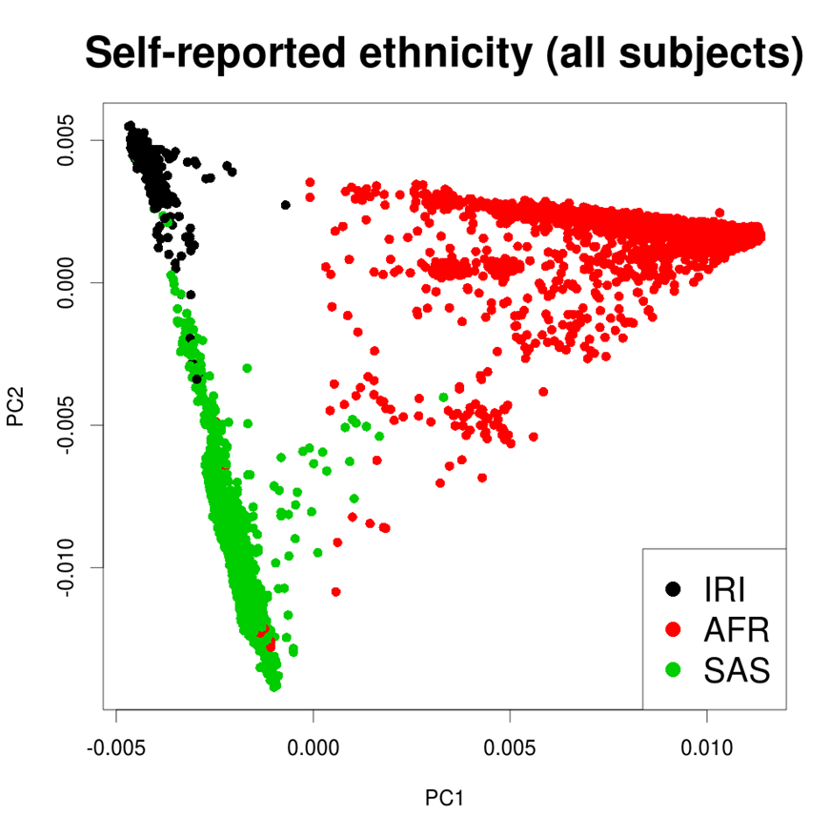
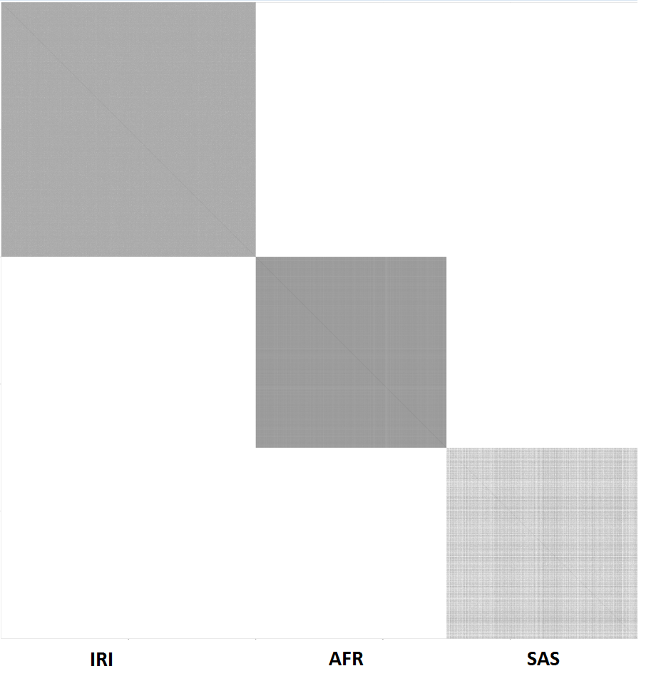
Thresholded GRM $(Σ)$ cannot be made sparse in multi-ancestry studies
Subset of UK Biobank
Naïve thresholded GRM is not sparse
Expensive computation
IRI
AFR
Threshold at 0.05
≈ after 4th degree
SAS
Generic penalized likelihood methods suffers the same problem
Population structure and family relatedness need to be disentangled.

Slide 23
FastSparseGRM: Fast Ancestry-Adjusted Sparse GRM
Obtain PCs
Use PC-AiR*
Ancestry-adjusted Gs
Regress out the PCs from the genotypes G
Calculate kinship using KING
Sparse GRM $(Σ_{s})$
Sparse GRM (𝚺_𝒔)
Calculate ancestry adjusted GRM elements only when kinships $≠0$
Calculate ancestry adjusted GRM elements only when kinships ≠0
(low rank part of $Σ$: Population structure)
(low rank part of 𝚺: Population structure)
Estimate family structure (block diagonal part of $Σ$)
𝚺 = low rank + block diagonal

Slide 24
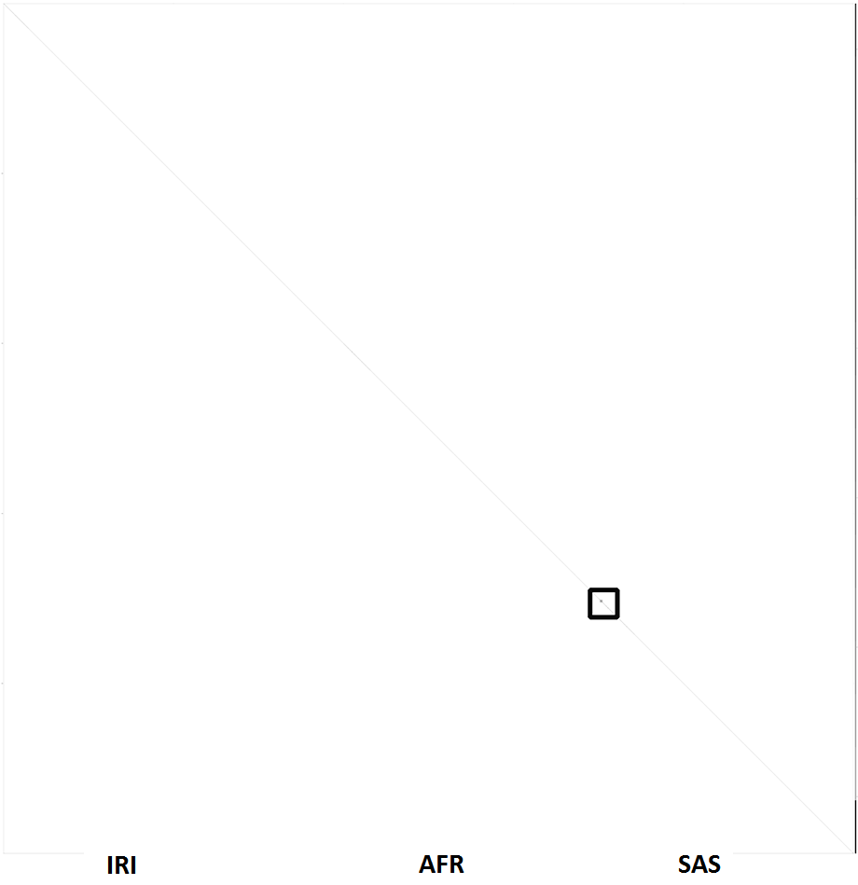
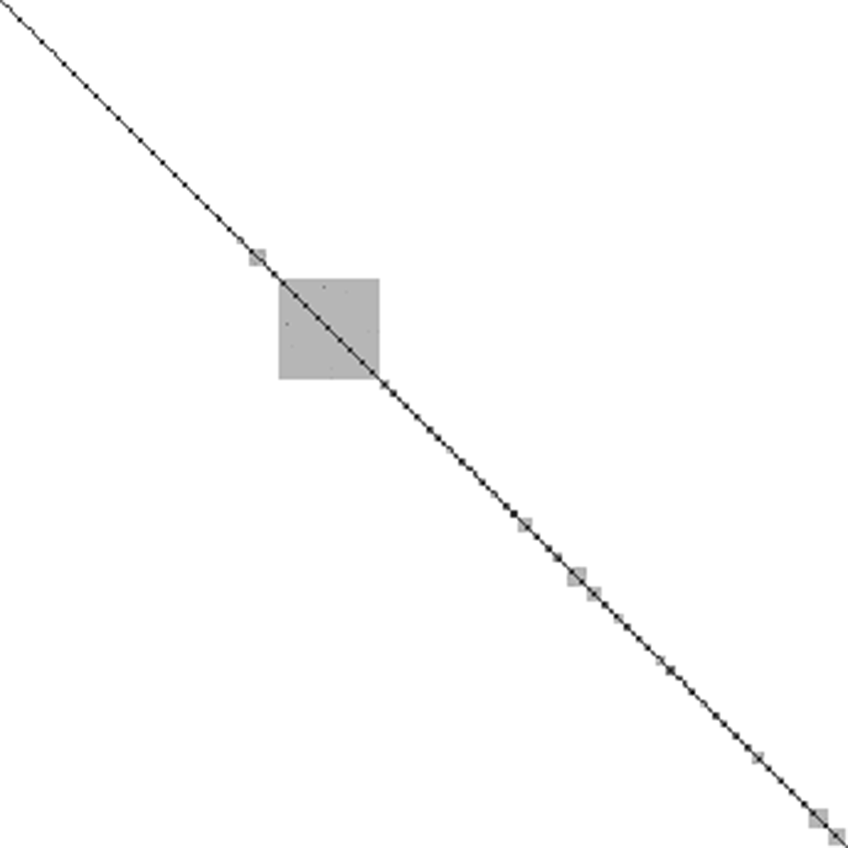
FastSparseGRM: Multi-ancestry UKB example
Thresholded Sparse GRM $(Σ_{s})$
Ancestry-adjusted Sparse GRM $(Φ_{s})$
Zoomed in view of $Φ_{s}$
Not sparse

Slide 25
Recommendation: Include both PCs and GRM in Mixed Models
Issue: GRM 𝚺 has both ancestry and relatedness information
Disentangle the roles of ancestry PCs and GRM:
PCs (FEs): Model population structures
Ancestry-adjust sparse GRM(REs): Model relatedness
Linear, logistic & loglinear mixed models (GLMMs):
$μ or logit\left(μ\right) or\log\left(μ\right)=Xβ+PCγ+Cα+b$,
where $b∼N\left(0,θΩ_{s}\right)$ and $Φ_{s}=$ ancestry-adjusted sparse GRM

Slide 26
Computational Cost using FastSparseGRM on All UKB Data (n=488K)
100 CPU cores used for GWAS
Model | Time (Hours) | Memory (GB)
Logistic MM | 4 | 33
Frailty Model | 4.4 | 40
Not feasible to compute a dense ancestry-adjusted GRM at UKB scale
FastSparseGRM nicely handles this at scale.

Slide 27
Part 4
Building an End-to-End WGS Integrative Analysis Ecosystem
Variant Functional Annotation
Pipeline Building
Cloud Deployment

Slide 28
Large Biobanks and WGS Studies are Diverse
Takeaway:
To make a real world impact,
statisticians need to build an end-end data science ecosystem and engage in data science engineering
Push the last mile: To deliver the product

Slide 29
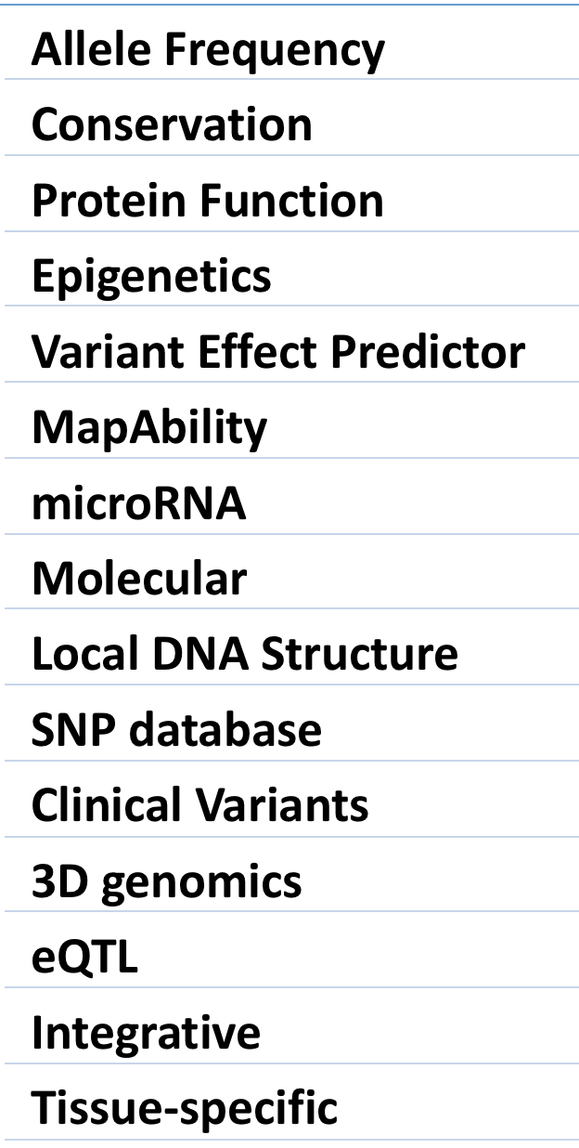
FAVOR: Whole Genome 9 Billion Variant Functional Annotation Database and Portal
FAVOR
ENCODE/
Roadmap
Annovar
CADD
GTEX
FANTOM
Other Sources
15 Types of Annotations
>300 annotations
80% built on hg38
favor.genohub.org
Zhou, et al, NAR, 2023

Slide 30
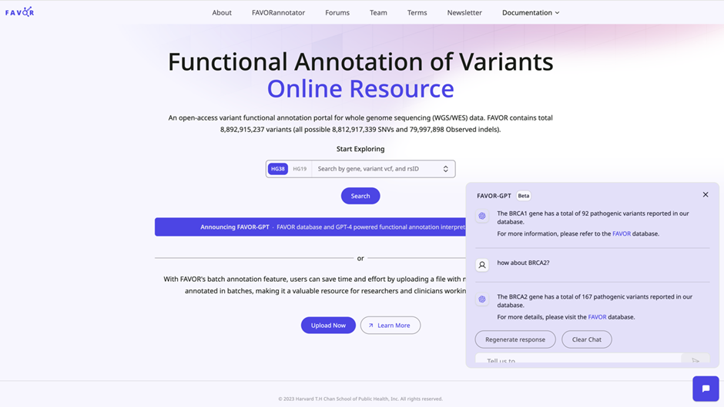
FAVOR-GPT
Harness the power of LLM to improve the user experience of using FAVOR
Build FAVOR-API using ChatGPT-API
FAVOR-GPT: LLM interface of FAVOR
Tom Li, Vineet Verma, Hufeng Zhou
rs7412
chr19-44908822-C-T
chr19-44908820-44908922
APOE

Slide 31
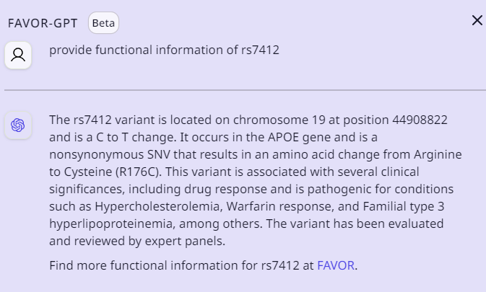
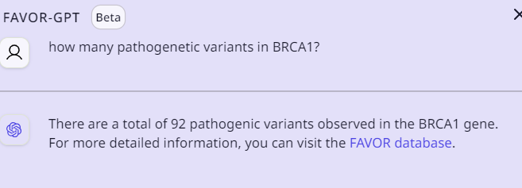
FAVOR-GPT Query Examples
Provide functional info of rs7412?
How many pathogenic variants does BRCA1 have?
rs7412
chr19-44908822-C-T
chr19-44908820-44908922
APOE

Slide 32
WGS DS Ecosystem: Cloud-Based Data Sharing and Computing
Bring Researchers to Shared Data
Workflow Description Language (WDL)
Workspace
Traditional cluster model:
Bring Data to Researchers
(Data sharing = Data copy)

Slide 33
Build Storage-Efficient and Analysis-Ready WGS Files
UK Biobank WGS Data on Cloud-based UKB RAP (n=200K)
Format | pVCF Sep 2022 | aGDS (annotated)
# of files | 60,648 files | 1 per chr
File size of chr1 | x00 TB | 38.83 GB
VCF files are very large
The annotated GDS (aGDS) file has genotype + annotations in a single file (1000 times smaller than VCF).

Slide 34
FAVOR-STAAR End-to-End WGS Analysis Pipeline in AnVIL
Raw Genotype (VCF)
GSP TOPMed
UKB
Phenotype (dbGAP)
QC
Genotype (VCF)
Functionally Annotated WGS Data (aGDS)
WGS Association Analysis
FAVORAnnotator
STAARpipeline
Cloud Ecosystems
NHGRI
NHLBI
UKB RAP
FAVOR
(9 billion variants)

Slide 35
Part 5: Interpretable Statistics and ML methods by Incorporating Domain Knowledge
Empower Rare Variants Association Tests by Incorporating Functional Annotations

Slide 36
STAAR: variant-Set Test for Association using Annotation information
Li, X., Li, Z., et al, Nature Genetics, 2020 (STAAR)
Li, Z., Li, X. et al, Nature Methods, 2022 (STAARpipeline)
Li, X., et al, Nature Genetics, 2023 (MetaSTAAR)
Xihao Li
UNC
Zilin Li
东北师大
Main idea: Boost power of RVATs by dynamically upweighting functional variants using multi-dimensional functional annotation scores

Slide 37
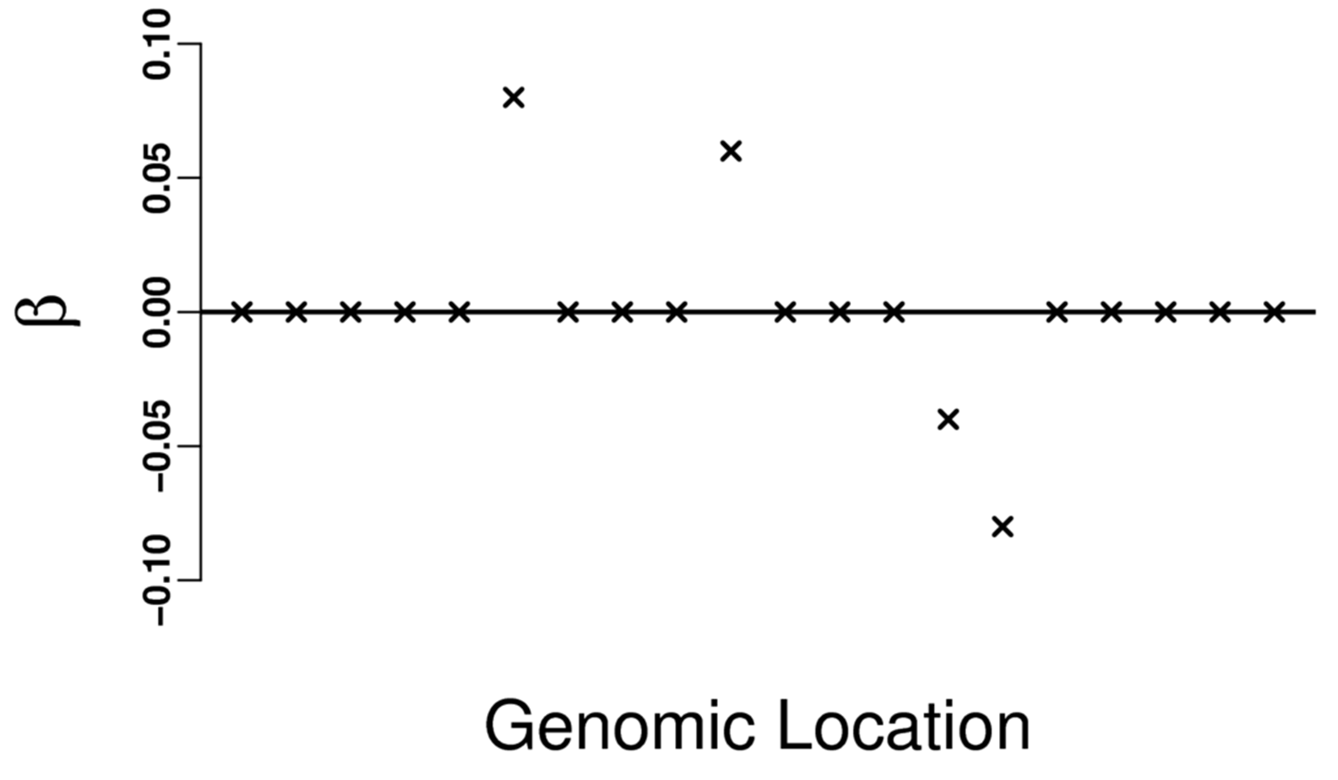
Challenges in WGS Rare Variant Association Test (RVAT)
Simple single SNV analysis in GWAS does not work
Need to perform SNV-set analysis
How to define SNV-set?
G=100 SNVs in APOE enhancer
Test $H_{0}:β=0$
(no association between APOE enhancer and LDL)
LDL$=Xβ+Cα+e$
Signal variant
APOE
enhancer
Main idea of RVAT: Aggregate individual SNV association test stats $U_{j}^{′}s$in a SNV set.

Slide 38
Create RV-Sets (Masks) using STAAR ($MAF<1\%$)
pLoF/pLoF + Disruptive Missense
Missense/Disruptive Missense
Synonymous
Coding
Gene-Centric
Analysis
Non-
Coding
Promoter/Enhancer (CAGE)
Promoter/Enhancer (DHS)
UTR/Upstream/Downstream
ncRNA genes
Challenges: Tissue and cell-specific
Sliding
Window
2kb sliding window procedure with 1KB skip length
Genetic Region
Analysis
Genetic Region
Analysis
SCANG
Dynamically detect window sizes and locations
Control the genome-wide type I error rate

Slide 39
Aggregated Cauchy Association Test (ACAT)
$U_{j}$=assoc score stat of SNV j
p=# of SNPs in APOE enhancer
Burden= $\sum_{j}^{p}{w_{j}U_{j}^{}}$ SKAT$=\sum_{j}^{p}{w_{j}^{2}U_{j}^{2}}$
Powerful if SNV effects on LDL in the same direction
Powerful if SNV effects on LDL in different directions
Transform p-value to Cauchy
Powerful correlated
p-value combination methods
ACAT$=\sum_{i=1}^{d}{w_{i}\tan\left\{\left(0.5−p_{i}\right)π\right\} }$
Yaowu Liu
(Liu, et al, AJHG, 2019)
Weights
ACAT can be used to combine p-values of different SNV-set tests
using different functional annotation weights.

Slide 40
A brief introduction to ACAT
If $p_{i}$’s are independent $χ^{2}\left(2B\right)=$
$$T_{Fisher}=\sum_{i=1}^{B}{ }{−2log⁡(p}_{i})$$
Limitation
If $p_{i}$’s are dependent complicated
$$χ^{2}(2)$$
If $p_{i}$’s are independent or perfect dependent
$Cauchy(0,\sum{c_{i}})=$
$$T_{ACAT}=\sum_{i=1}^{B}{c_{i}\tan\left\{\left(0.5−p_{i}\right)π\right\} }$$
Advantage
tail
If $p_{i}$’s are dependent
$Cauchy(0,\sum{c_{i}})≈$
$$Cauchy(0,1)$$
Weights
Liu, et al, AJHG, 2019; Liu and Xie, JASA, 2020

Slide 41
STAAR WGS Analysis Flow
Use FAVORAnnotator

Slide 42
WGS Computation Cost of STAARpipeline on UKB RAP (n=185K)
Analysis | STAARpipeline Cloud Cost
FAVORannotator | $24.10 (>1 billion variants)
Null Model | <$0.25
Gene-Centric Coding (5 masks) | $6.00
Gene-Centric Noncoding (7 masks) | $26.45
ncRNA (1 mask) | $5.72

Slide 43
Part 5 WGS RVAT Takeaways
FAVOR/FAVOR-GPT: Provide a comprehensive whole genome variant functional annotation database and portal of 3 billion positions.
FAVORAnnotator can functionally annotate any WGS/WES study
By dynamically incorporating multiple variant functional annotations, STAAR boosts the power of WGS rare variant association analysis.
cellSTAAR: Tissue and cell-specific functional annotations can boost power of RVATs.

Slide 44
Part 6 Takeaway:
Ensemble is a Good Thing
From ensemble prediction to ensemble inference

Slide 45
Empower Rare Variants Association Tests using Ensemble Testing
Goal: Improve the power of Burden and SKAT
JRSS-B 2024
Yaowu Liu, 西南财经大学

Slide 46
Motivation for Ensemble Testing
Is the Burden test the best test assuming the same effect sign?
No, as it assumes all $β_{j}^{′}s$ are equal: $β_{j}=β$.
How to develop a powerful test assuming the same effect sign with diff values?
$$H_{0}:β=0 vs H_{1}:β>0$$
dim(𝜷) is large

Slide 47
Random Forest (Ensemble Prediction)
Dataset
Every tree is built on a bootstrap sample.
$m$ variables (e.g. $m=\sqrt{p}$) are randomly selected to build a tree
Ensemble: Average of the B trees.
Bootstrap 1
Bootstrap 2
Bootstrap B
……………………
Tree 1
Tree 2
Tree B
RandomForest
Prediction 1
Prediction 2
Prediction B
……………………
Remark: Bagging uses $m=p$
Final Prediction

Slide 48
Question Given the success of ensemble methods for prediction, can we develop ensemble methods for hypothesis testing?
From ensemble prediction to ensemble testing

Slide 49
Ensemble Test . Introduce random weights in base test statistics . Use ACAT method to combine p-values of different base tests
Ensemble learning: Random Forest
Base learner 1
Prediction 1
Base leaner 2
Prediction 2
Final prediction
Ensemble learner
… …
… …
Prediction B
Data
Base learner B
Base learner (weak) = tree Ensemble learner (strong)=RF
Ensemble Testing
Base test 1
P-value 1
Base test 2
P-value 2
Final p-value
Ensemble test
… …
… …
P-value B
Data
Base test B

Slide 50
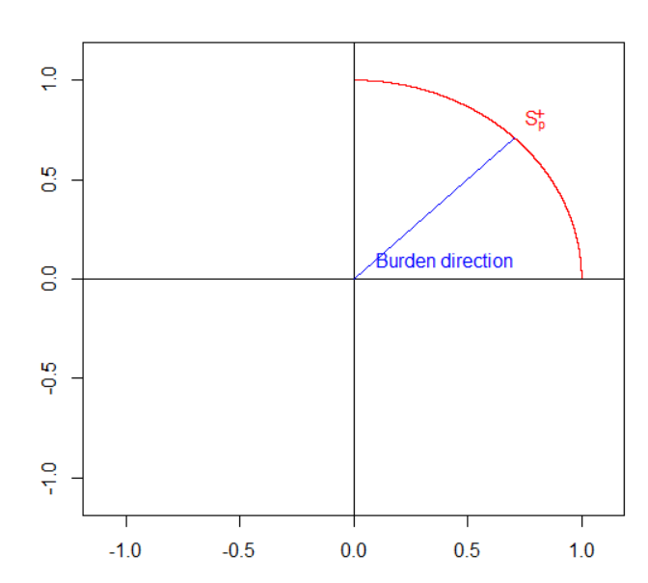
Burden test
The orcale test should use the true unknown signal direction $T_{β}=β^{T}U$
Burden test uses $w=1$, as
$T_{burden}=1^{T}U$
Is the Burden direction a
good choice?
true $β$
Burden test assumes $β_{j}^{′}s$ are all equal: $β_{j}=β$
Ensemble testing: generate many random directions in 1st quadrature)
Notes:
Explain what the burden test is, i.e., calculate sum of X and regress Y on sum of X

Slide 51
Workflow of Ensemble Burden Test
$$T_{1}=w_{1}^{T}U$$
P-value 1
$$w_{1}$$
$$w_{2}$$
$$T_{2}=w_{2}^{T}U$$
P-value 2
Final p-value
EN-Burden
… …
… …
… …
P-value B
$$w_{B}$$
Data
Use Cauchy based approximation
$$T_{B}=w_{B}^{T}U$$
Random weights
Base burden test
ACAT to combine
p-values
Generate $w_{i}>0$ randomly (random directions in 1st quadrature)
Simulate $w_{i}$ via MVN: $w_{i}=({\frac{\left|Z_{i1}\right|}{\left\|Z_{i}\right\|},\frac{\left|Z_{i2}\right|}{\left\|Z_{i}\right\|},⋯,\frac{\left|Z_{ip}\right|}{\left\|Z_{i}\right\|})}^{T},Z_{i}\sim N_{p}(0,A)$
A=variant functional annotations

Slide 52
Analysis ARIC WGS data analysis: number of significant 4kb sliding windows (p< 𝟑.𝟕𝟓×${10}^{−8}$)
Burden
 | Beta(1,1) | EN-Beta(1,1) | Beta(1,25) | EN-Beta(1,25)
Lipoprotein(a) | 8 | 79 | 6 | 54
Neutrophil count | 20 | 79 | 8 | 43
SKAT
 | Beta(1,1) | EN-Beta(1,1) | Beta(1,25) | EN-Beta(1,25)
Lipoprotein(a) | 103 | 171 | 127 | 184
Neutrophil count | 113 | 149 | 62 | 126

Slide 53
Summary of Ensemble Test
Ensemble test is a flexible and robust way to boost the power of weak base tests
Ensemble test introduces random weights in base tests and ensemble them using ACAT.

Slide 54
Large Biobanks and WGS Studies are Diverse
Part 7 Takeaway:
Be open-minded, Think out of box, Take risk

Slide 55
ChatGPT: Large Language Model (LLM)
Number of parameters in ChatGPT LMMs:
ChatGPT 3: 175 billions
ChatGPT 4: 1 trillions
Statistician (me) first reaction:
Overfitting?
How can it work?
AI/Engineering mindset:
Make it work

Slide 56
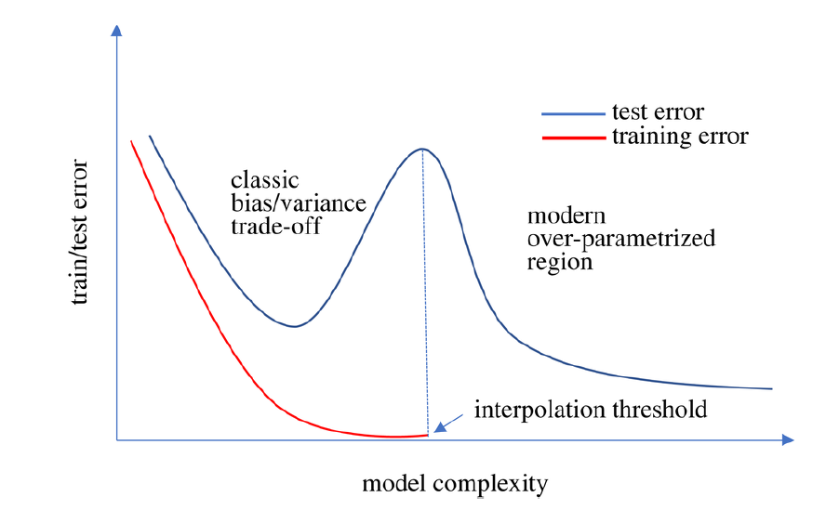
Benign Overfitting and Double Descent
Phase transition
Chawla et.al. (2023)

Slide 57
Step out of our comfort zone
Cultivate an engineering/CS mindset
Disruptive statistics

Slide 58
Final Remarks
Be a full scientist
Build a scalable and interpretable end-to-end data science ecosystem using stats, ML and domain science
Be open-minded, willing to take risk when embracing new technology
Prioritize impact, onward together

